Slide 1




The massive economic costs of
biological invasions worldwide
Diagne Christophe, Leroy Boris, Gozlan Rodolphe, Roiz, David, Vaissière Anne-Charlotte, Salles Jean-Michel, Jaric Ivan, Bradshaw Corey, Angulo Elena, Turbelin Anna, Ballesteros-Mejia Liliana & Courchamp Franck
franck.courchamp@cnrs.fr
20/08/21

Slide 2
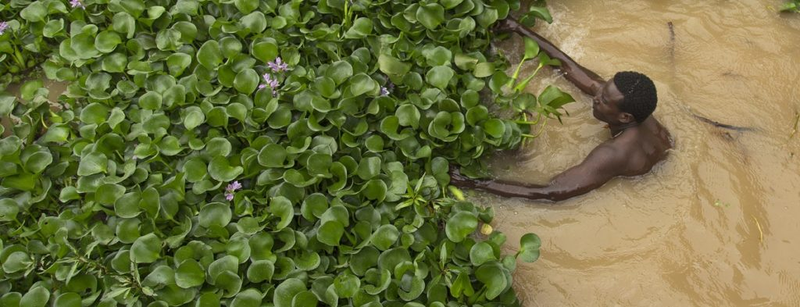
Biological invasions
Invasive alien species
Alien species that establish, spread and become impactful

Slide 3
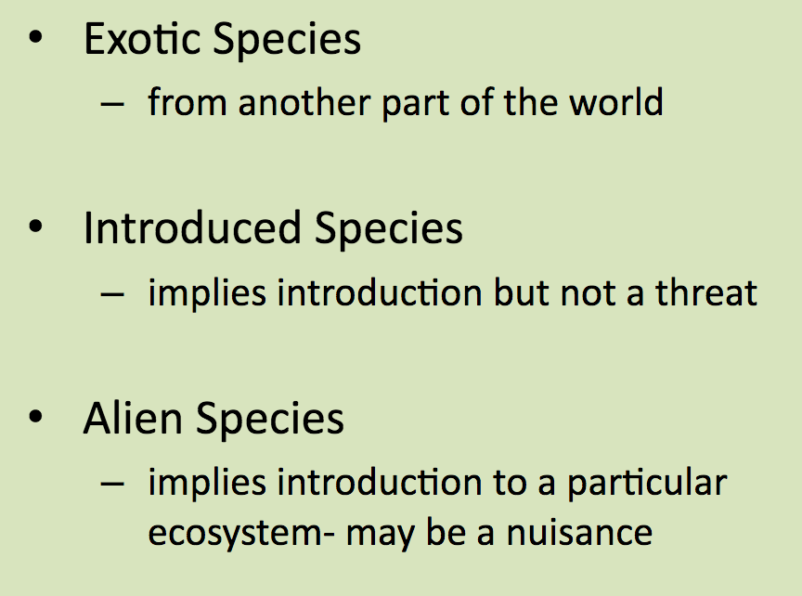
Not all exotic species become invasive
The 10% rule

Slide 4
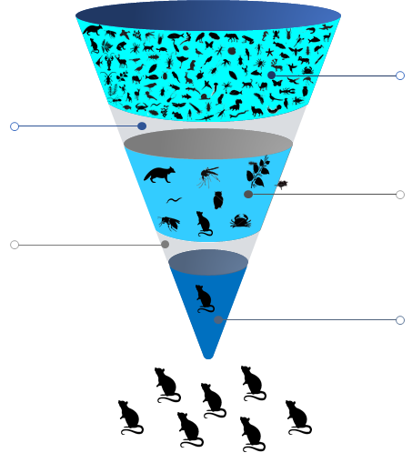
The 10% rule
Introduction
10%
Establishment
10%
Invasions
But 10% of thousands of species is still a lot…

Slide 5
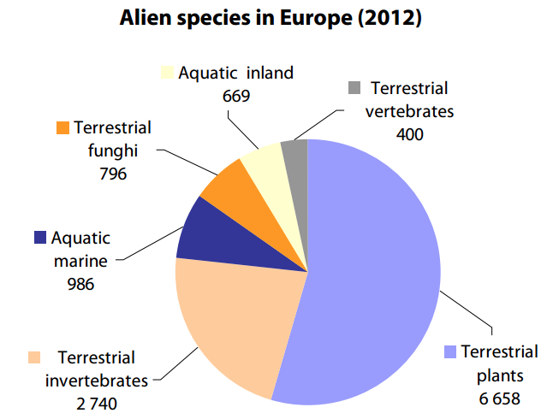
~14 000 alien species in Europe
Perhaps around 5 000 invasive

Slide 6
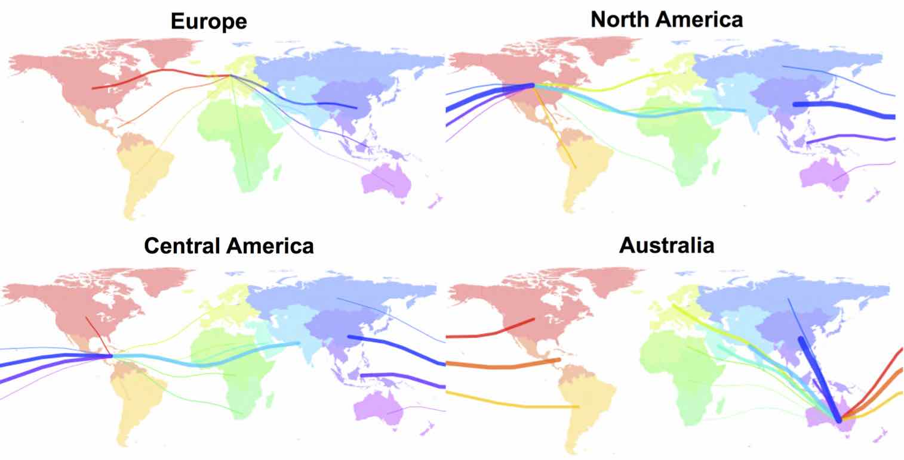
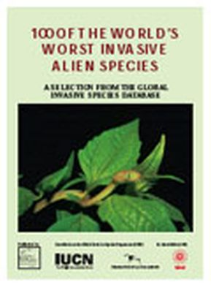
Tens of thousand of IAS in the world,
from everywhere to everywhere
Origins of the “100 of the world’s worst invasive alien species” – ISSG IUCN

Slide 7

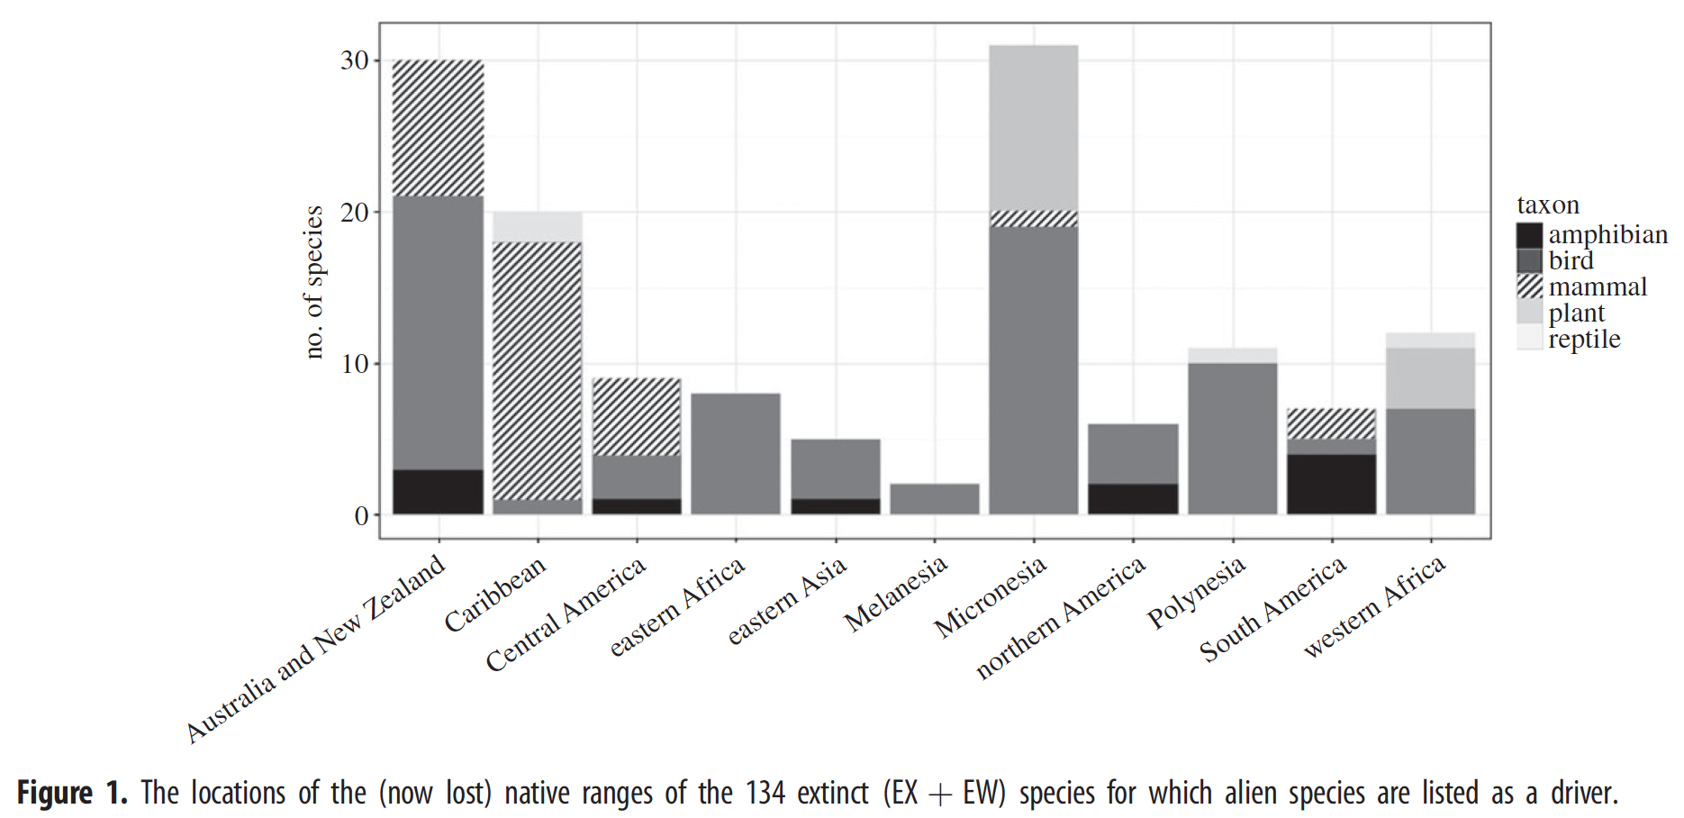
Biological invasions are a
major cause of recent extinctions

Slide 8

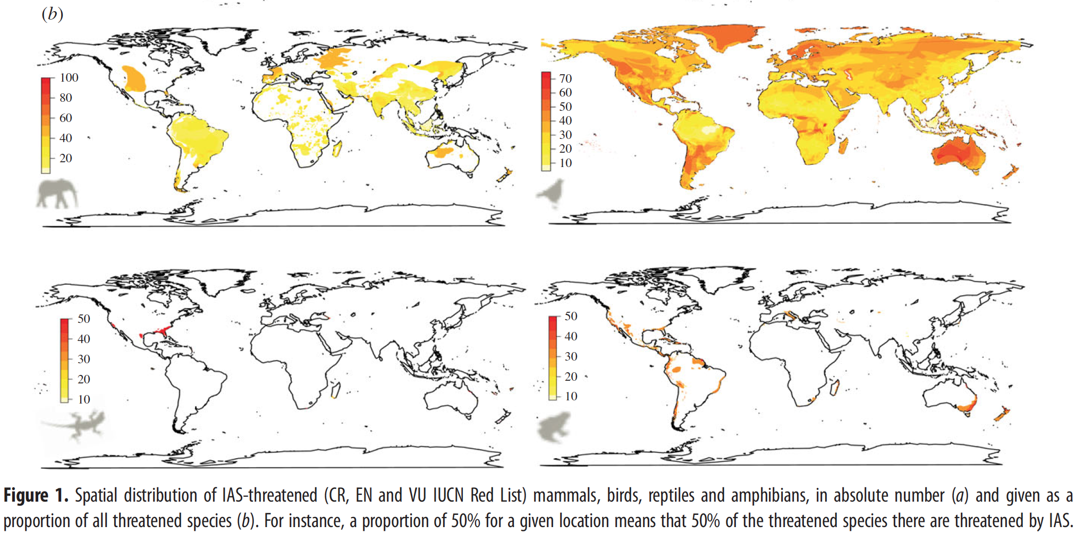
Biological invasions are currently the second threat on biodiversity

Slide 9
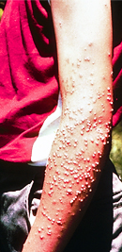
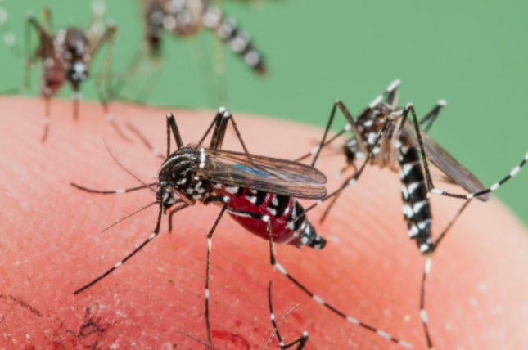
Biological invasions have an impact on human societies
Sanitary costs
Allergies, bites, stings, …
Insect vector borne lethal diseases
Tens of thousands of deaths and millions of medical care worldwide each year

Slide 10
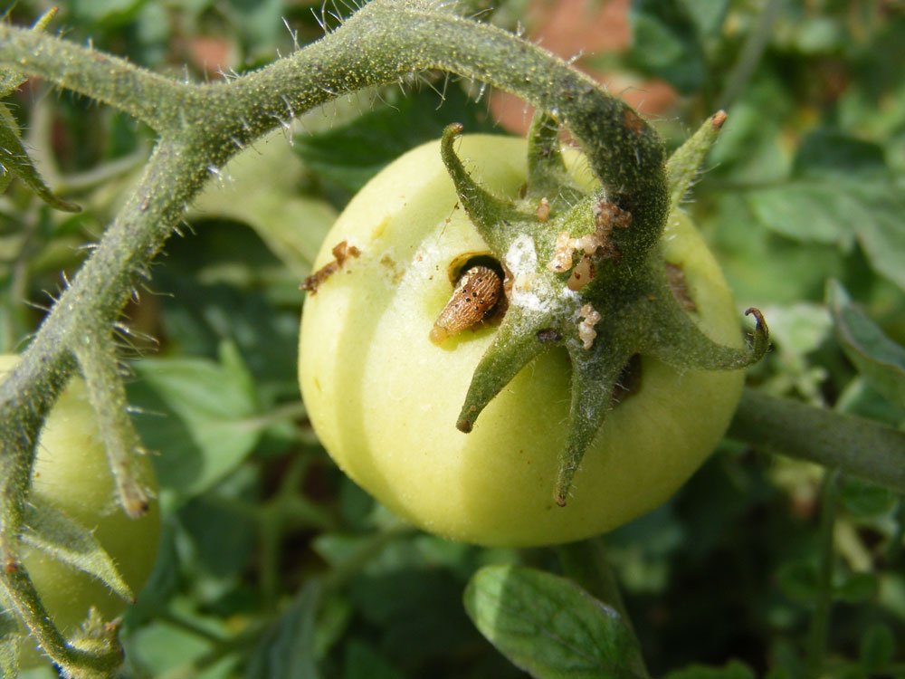
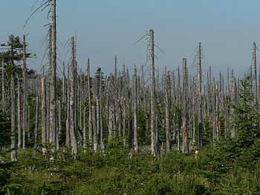
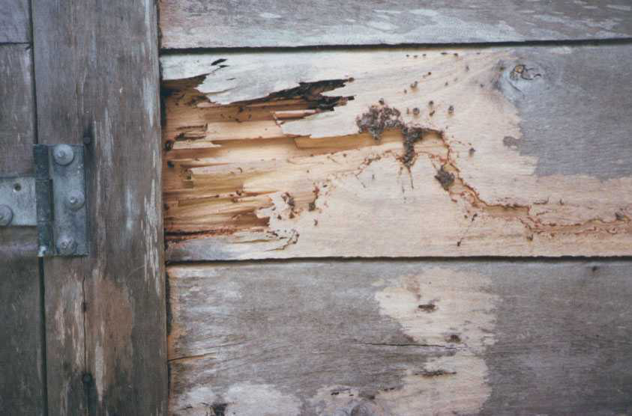
Biological invasions have an impact on human societies
Economic costs
Agricultural losses (beekeeping, horticulture, viticulture, fisheries, aquaculture…)
Forestry losses
Real estate and infrastructure losses
Tourism losses
…

Slide 11

Paradox of biological invasions
Neither the public, nor decision makers
are really aware of the issue

Slide 12
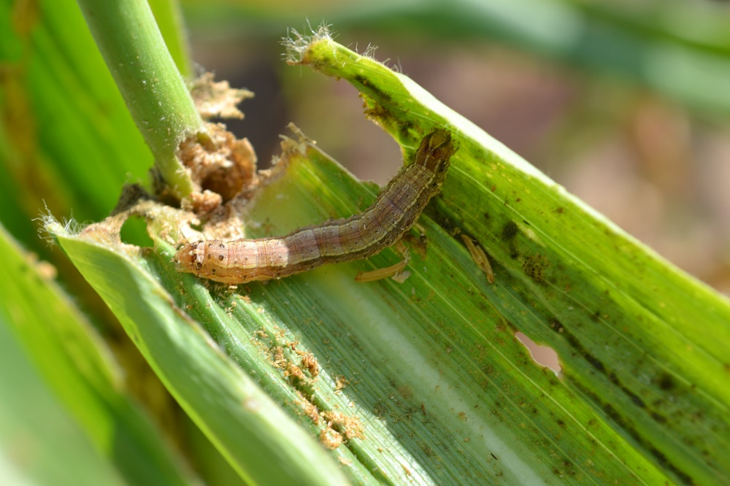
Paradox of biological invasions
Invasive species create
Huge ecological problems
Huge sanitary, social and economical problems
and yet, biological invasions are little known as a major problem
Fall Armyworm

Slide 13

Why are politicians/people willing to protect biodiversity but don’t know/care about biological invasions?

Slide 14
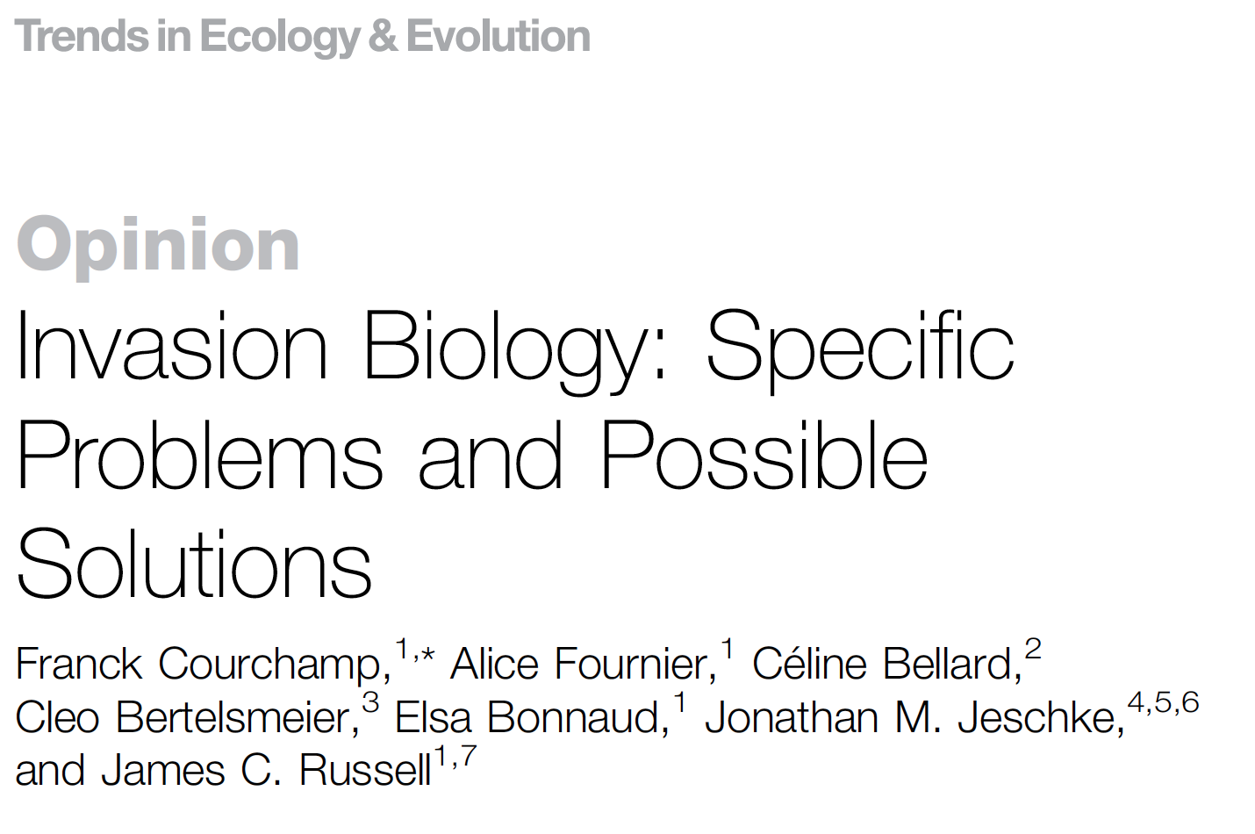
24 specific issues
That make it more difficult to
Understand
Alert
Support
Implement

Slide 15




Difficulties
Understanding
Supporting
Poorly understood concepts
Confusion between
invasive & introduced
Lack of scenarios
Blurry definitions
Sympathy for many IAS
Blurry concepts
Reluctance to kill
Invasion biologists
seen as biased
Evolving concepts
Field-specific frameworks
Recommendations seen as constraints to liberty
Actions indirectly positive
Difficult measure & demonstration of impacts
Most cases are
local problems
Difficult anticipation of system evolution
Lack of iconic victim
Lack of general rules
Blurry legal frameworks
Local scale interests
Heterogeneous legal frameworks
Lack of knowledge on many systems
No definitive success
Multifaceted threat
Twisted
Tragedy of the Commons
Alerting
Implementing

Slide 16

One way to quantify impacts, but also to touch non-scientists is to use a metrics that they are familiar with: currencies

Slide 17
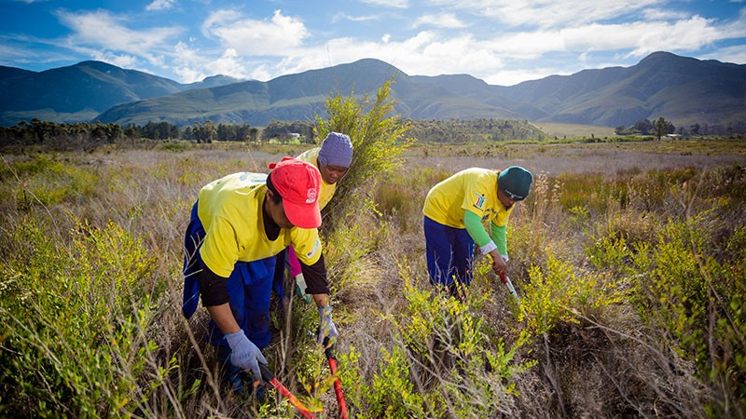
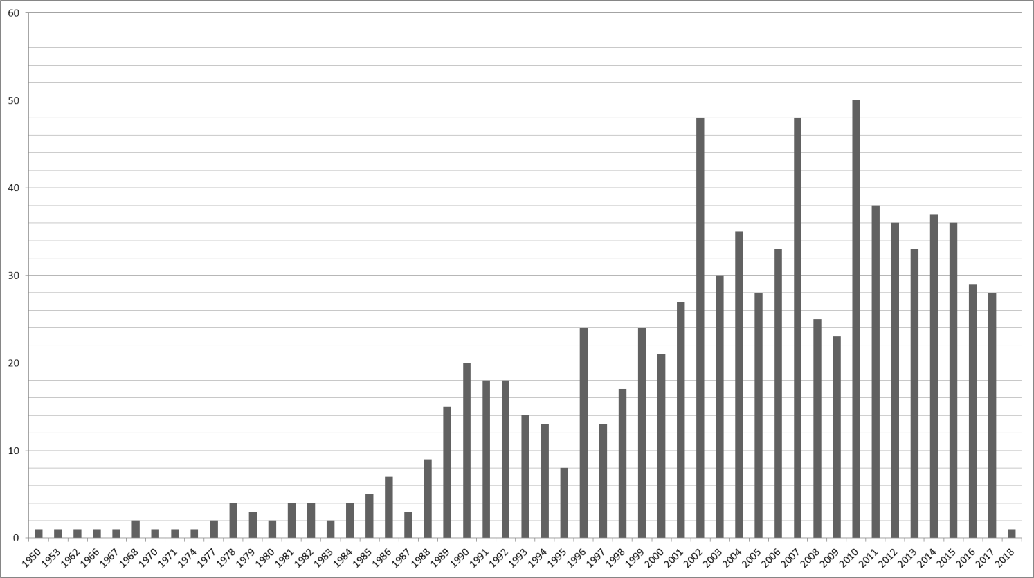
There are studies on the
economic costs of biological invasions
even increasing worldwide

Slide 18
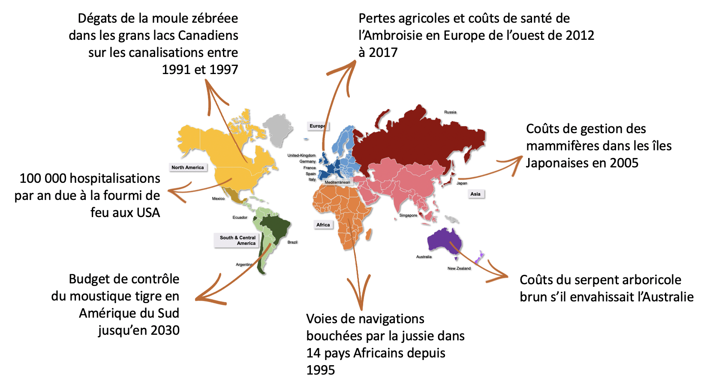
Damages by the zebra and quagga mussels in Canadian lakes from 1991 to 1997
Yield losses in agriculture and health costs due to Ambrosia in Western Europe from 2012 to 2017
Management costs of invasive mammals in Japanese islands in 2005
100,000 yearly hospitalisations due to the Red Imported Fire Ant in the USA
Potential cost of the Brown Tree Snake if it were to invade Australia
Control program of the invasive tiger mosquitoe in South America from 1990 to 2030
Waterways blocked by the floating primrose-willow in 14 African countries since 1995
No possible compilation
No possible comparison
No possible synthesis
temporal and spatial scales,
location,
type of costs (damage vs management),
observed vs potential costs, …

Slide 19
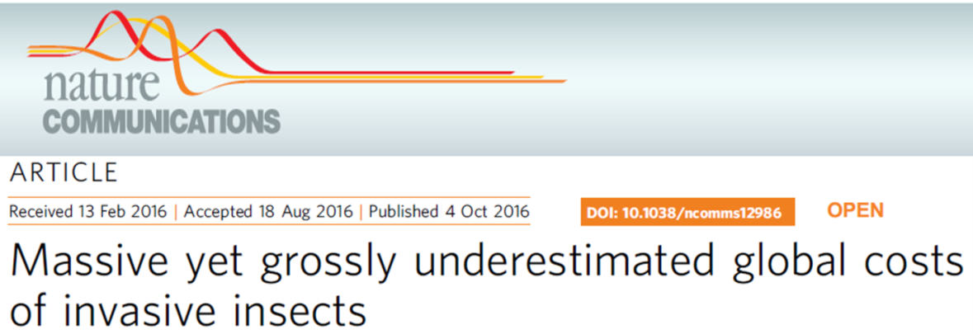
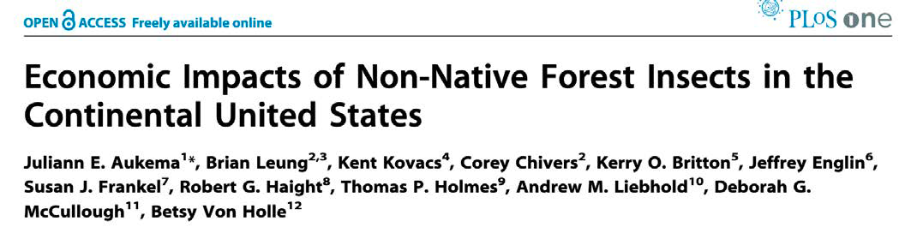
There are studies on the
economic costs of biological invasions
Mainly restricted to particular taxa, areas, sectors,…

Slide 20
There are studies on the
economic costs of biological invasions
Not standardized, difficult to compare/compile

Slide 21
There are studies on the
economic costs of biological invasions
Not standardized, difficult to compare/compile
Need for a reliable synthesis at a global scale

Slide 22
There are studies on the
economic costs of biological invasions
Not standardized, difficult to compare/compile
Need for a reliable synthesis at a global scale
InvaCost = the first global compilation of published economic costs of biological invasions

Slide 23
We reviewed the literature for studies with explicit estimations of costs of invasive alien species
Compile, standardize, describe and analyze economic cost estimates associated with invasions globally

Slide 24



We reviewed the literature for studies with explicit estimations of costs of invasive alien species
Compile, standardize, describe and analyze economic cost estimates associated with invasions globally
Develop a defensible, systematic, transparent and repeatable work strategy for data collection
Freely accessible
Collaborative & updatable
Useful for research & management

Slide 25
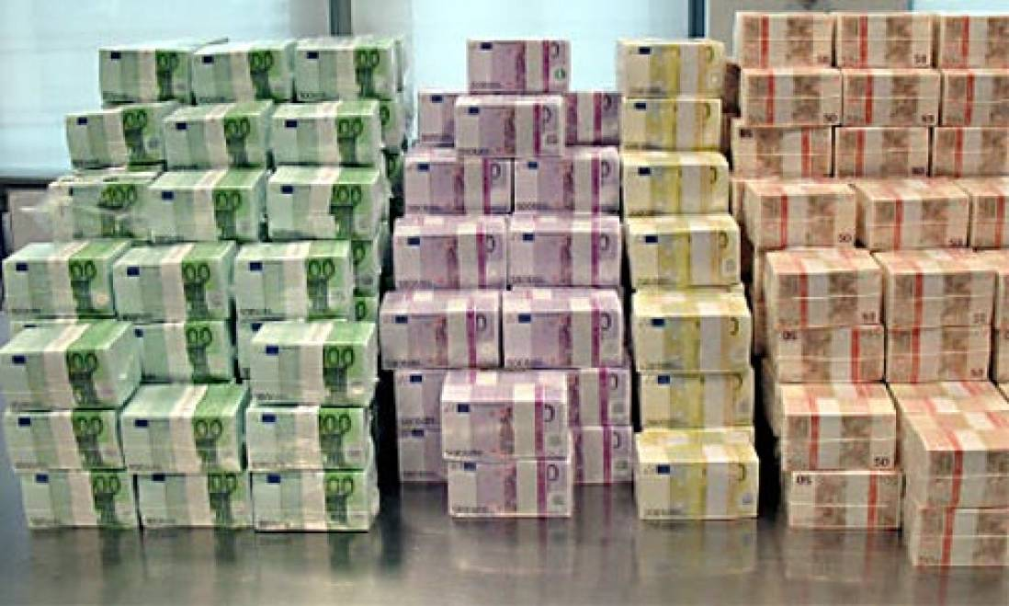
We reviewed the literature for studies with explicit estimations of costs of invasive alien species
Compile, standardize, describe and analyze economic cost estimates associated with invasions globally
Develop a defensible, systematic, transparent and repeatable work strategy for data collection
3 steps

Slide 26




An extensive literature search
→ Specific search strings
→ Requests to experts
Searching references in
peer-reviewed and grey literature

Slide 27
An extensive literature search
→ Specific search strings
→ Requests to experts
Searching references in
peer-reviewed and grey literature
(econom* OR cost OR monetary OR dollar OR euro OR "sterling pound") AND (invasi* OR alien OR non-indigenous OR nonindigenous OR nonnative OR non-native OR exotic OR introduced OR naturali* OR invader) NOT (cancer* OR cardio* OR surg* OR carcin* OR engineer* OR rotation OR ovar* OR polynom* OR purif* OR respirat* OR "invasive technique" OR carbon OR fuel OR therap* OR vehicle OR cell* OR drug OR fitness OR "operational research" OR banking OR liberalization)

Slide 28

15 different languages
إثراء اللغات غير الإنجليزية للمعرفة العلمية: التكاليف الاقتصادية للغزو البيولوجي نموذ
非英语数据能够完善科学知识：以生物入侵造成的经济损失为例
非英語言語が科学的知識を強化する：外来種の侵入の経済コストの事例
Non-English languages enrich scientific knowledge: the example of economic costs of biological invasions
Γλώσσες πέραν της αγγλικής εμπλουτίζουν την επιστημονική γνώση: παράδειγμα από τα οικονομικά κόστη βιολογικών εισβολών
Неанглійські мови збагачують наукові знання: приклад економічних збитків від біологічних інвазій.
Neengleski jezici obogaćuju znanstveno znanje: primjer ekonomskih troškova bioloških invazija

Slide 29

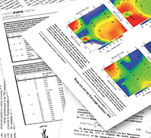

An extensive literature search
→ Specific search strings
→ Requests to experts
Searching references in
peer-reviewed and grey literature
Screening materials to assess relevance

Slide 30


An extensive literature search
→ Specific search strings
→ Requests to experts
Searching references in
peer-reviewed and grey literature
Screening materials to assess relevance
Collating and standardizing cost estimates

Slide 31


Conversion into a single currency
TL
Turkey Lira
United States Dollars
2017

Slide 32


A full description of each cost estimate

Slide 33
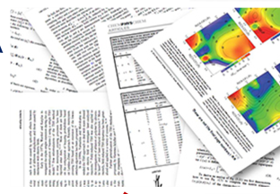
A full description of each cost estimate
Reference
Title, authors, publication year, etc.

Slide 34


A full description of each cost estimate
Reference
Taxonomy
Title, authors, publication year, etc.
Kingdom of species (GBIF) & vernacular name

Slide 35

A full description of each cost estimate
Reference
Taxonomy
Title, authors, publication year, etc.
Kingdom of species (GBIF) & vernacular name
Study
Spatial coverage, time range, impacted area, etc.

Slide 36

A full description of each cost estimate
Reference
Taxonomy
Title, authors, publication year, etc.
Kingdom of species (GBIF) & vernacular name
Study
Typology of costs
Spatial coverage, time range, impacted area, etc.
Impacted sector, method assessment, nature, etc.

Slide 37
Typology of costs
How to classify them?

Slide 38
Typology of costs
GOODS & SERVICES
HUMAN HEALTH
ECOSYSTEM PROCESSES
ECOLOGY

Slide 39
Typology of costs
GOODS & SERVICES
HUMAN HEALTH
ECOSYSTEM PROCESSES
ECOLOGY
prevention
damage
response

Slide 40
Typology of costs
GOODS & SERVICES
HUMAN HEALTH
ECOSYSTEM PROCESSES
ECOLOGY
prevention
damage
response

Slide 41
Typology of costs
clean up
education
GOODS & SERVICES
HUMAN HEALTH
vector control
damage repair
Production Class:
agriculture, forestry,
apiculture, horticulture,
aquaculture, …
infrastructure
Medical Care:
treatment,
hospital,
transport,
staff, …
medical research
Cultural Services:
tourism,
recreation, …
Illness:
productivity loss,
mobility loss,
DALYs, indirect costs, …
policy & legal changes,
implementation,
collateral health
& safety, …
specialist training,
prevention policy,
vaccination, …
natural-areas preservation
quarantine measures
ecological research
species protection
pest control
species
surveillance
reduced abundance &
range of native species,
extinctions, …
carbon regulation & storage,
soil fertility, pollination,
nutrient cycling, fresh water, …
pest control
ECOSYSTEM PROCESSES
ECOLOGY
restoration programs,
education
prevention
damage
response

Slide 42
Typology of costs
monetizable cost & direct utility
monetizable cost & direct utility
clean up
education
GOODS & SERVICES
HUMAN HEALTH
vector control
damage repair
Production Class:
agriculture, forestry,
apiculture, horticulture,
aquaculture, …
infrastructure
Medical Care:
treatment,
hospital,
transport,
staff, …
medical research
Cultural Services:
tourism,
recreation, …
Illness:
productivity loss,
mobility loss,
DALYs, indirect costs, …
policy & legal changes,
implementation,
collateral health
& safety, …
specialist training,
prevention policy,
vaccination, …
natural-areas preservation
quarantine measures
ecological research
species protection
pest control
species
surveillance
reduced abundance &
range of native species,
extinctions, …
carbon regulation & storage,
soil fertility, pollination,
nutrient cycling, fresh water, …
pest control
ECOSYSTEM PROCESSES
ECOLOGY
restoration programs,
education
prevention
damage
response

Slide 43
Typology of costs
monetizable cost & direct utility
monetizable cost & direct utility
clean up
education
GOODS & SERVICES
HUMAN HEALTH
vector control
damage repair
Production Class:
agriculture, forestry,
apiculture, horticulture,
aquaculture, …
infrastructure
Medical Care:
treatment,
hospital,
transport,
staff, …
medical research
Cultural Services:
tourism,
recreation, …
Illness:
productivity loss,
mobility loss,
DALYs, indirect costs, …
policy & legal changes,
implementation,
collateral health
& safety, …
specialist training,
prevention policy,
vaccination, …
natural-areas preservation
quarantine measures
ecological research
species protection
pest control
reduced abundance &
range of native species,
extinctions, …
carbon regulation & storage,
soil fertility, pollination,
nutrient cycling, fresh water, …
pest control
ECOSYSTEM PROCESSES
ECOLOGY
restoration programs,
education
prevention
damage
response

Slide 44
Data selection
Damages
Damages
Management
Management
Observed
Observed
Potential
Potential
Low reliability
Low reliability
High reliability
High reliability
Damages
Management
Observed
Potential
Low reliability
High reliability

Slide 45
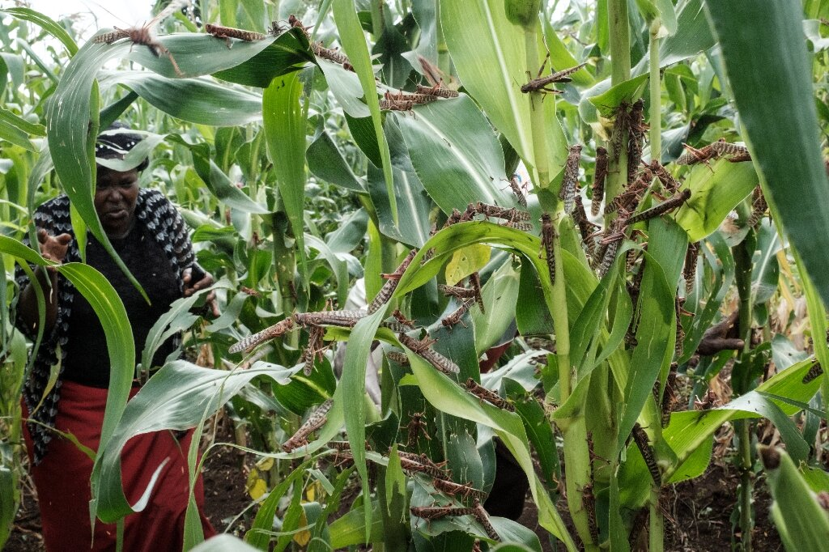

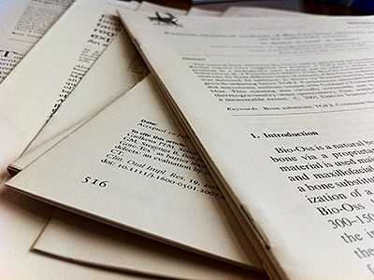
> 13,000 cost entries
> 60 descriptors

Slide 46
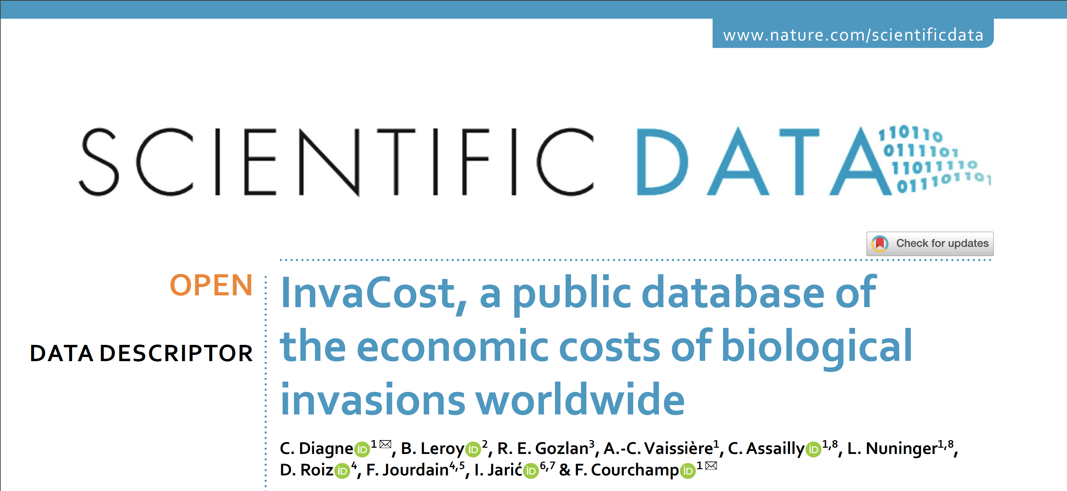

Slide 47

~ 10,000 cost entries
~ 60 descriptors

Slide 48
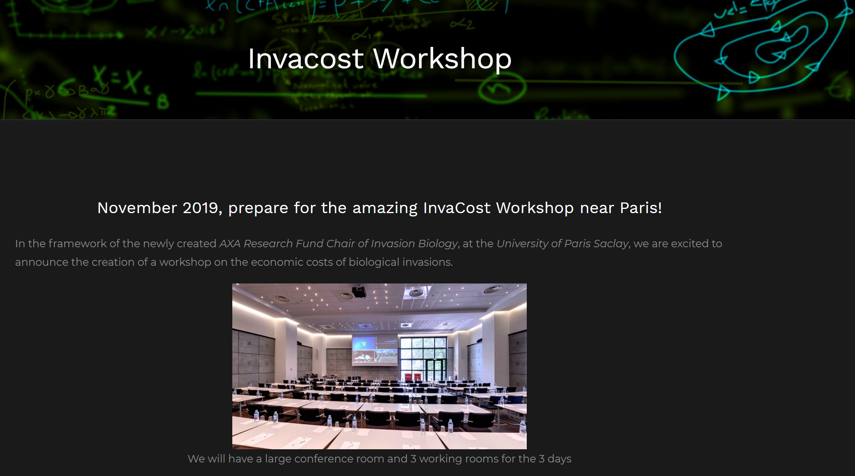
Workshop
to share the database and launch projects to analyse it

Slide 49
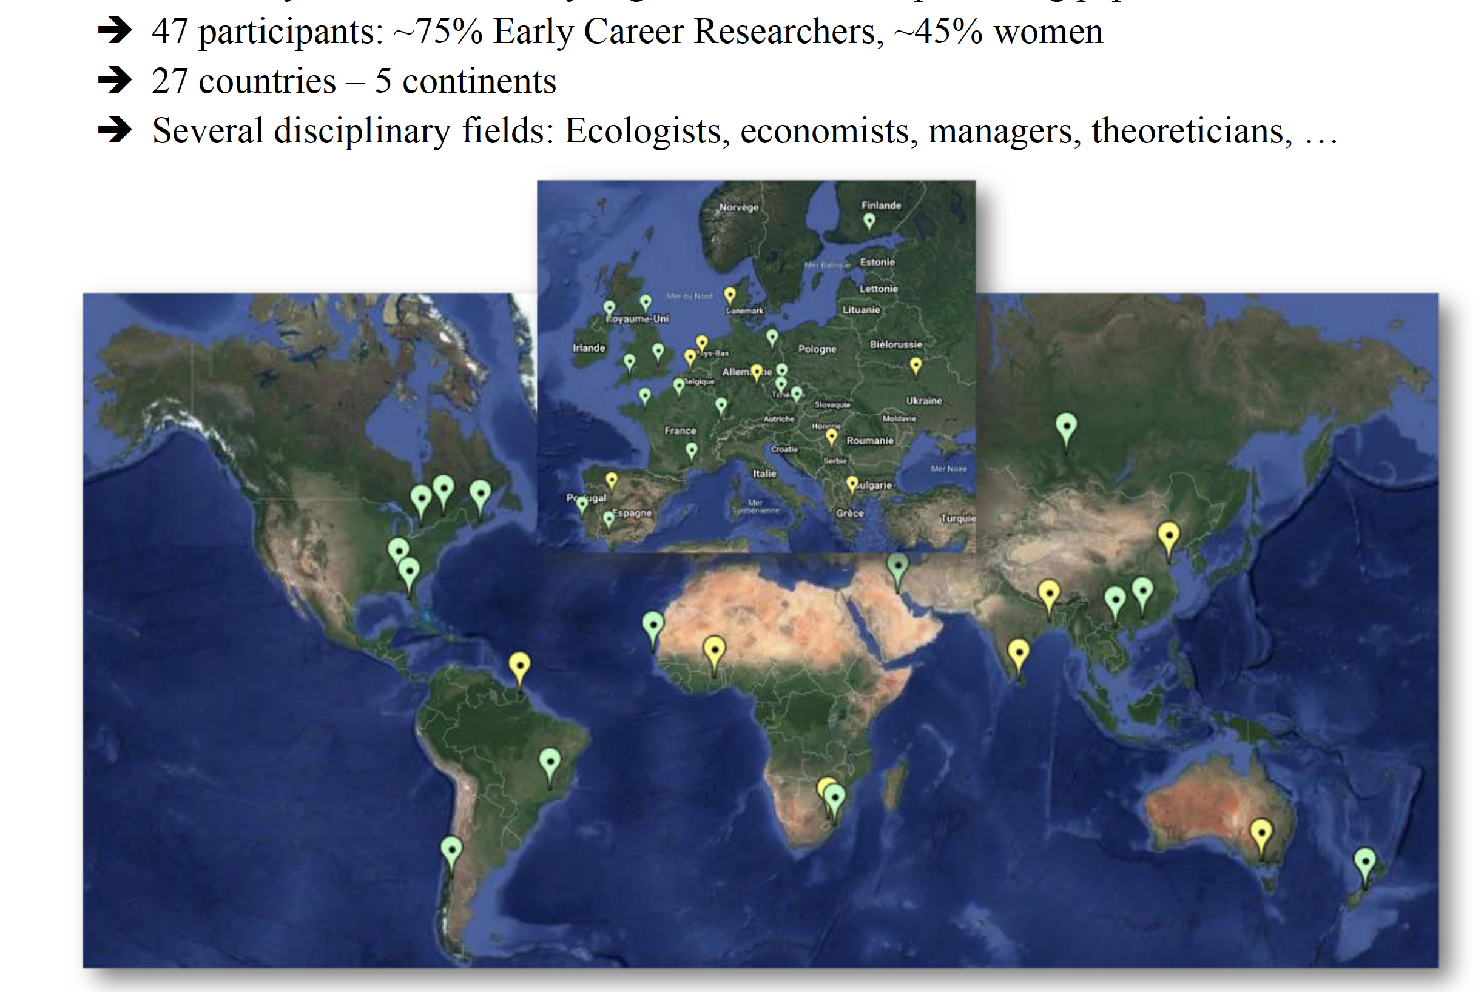

Slide 50
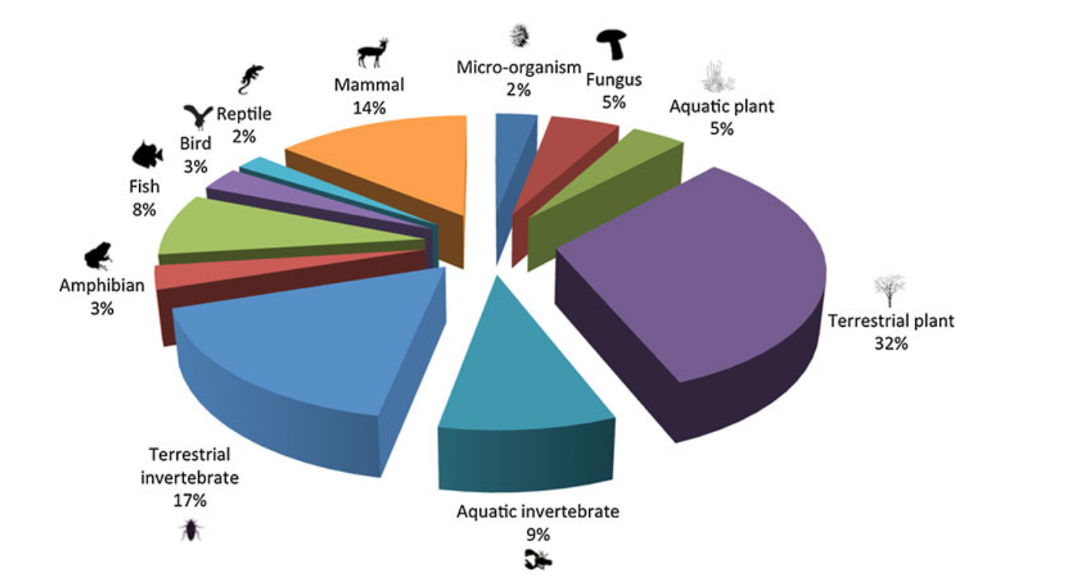
Cost from major taxa
terrestrial invertebrates
mosquitoes
Fish
terrestrial vertebrates
ambrosia
bivalves
rats
decapods
11 detailed studies
ants
Plants
aquatic

Slide 51
Cost for major regions
23 detailed studies

Slide 52
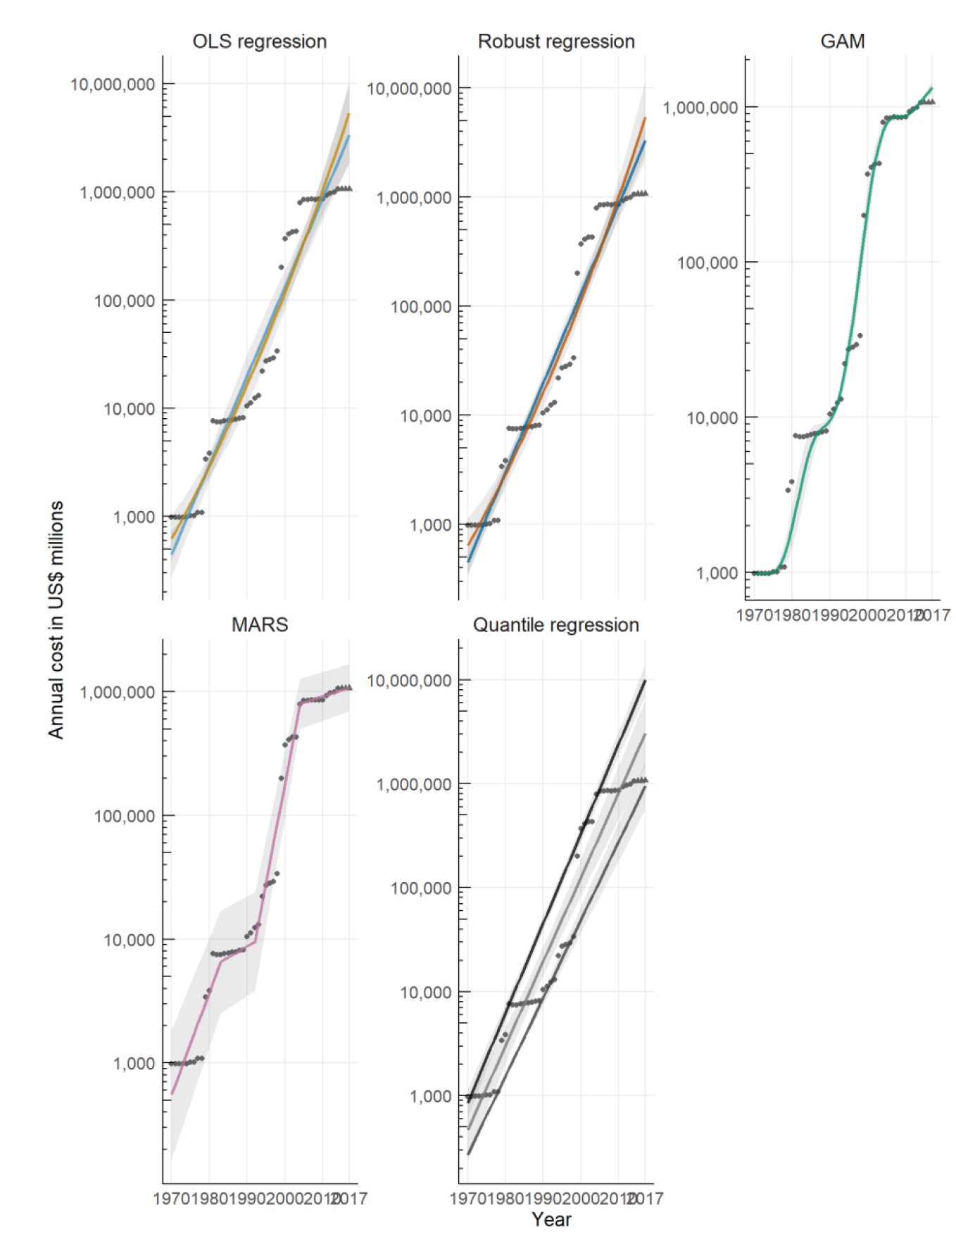
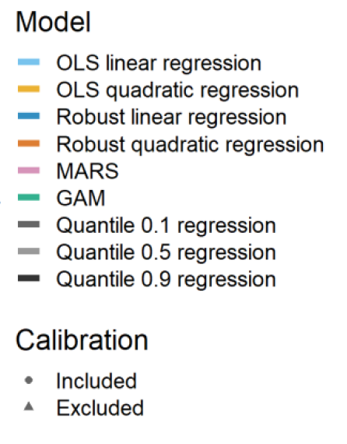
Conceptual studies
Understanding
Describing
Predicting
Extrapolating
27 studies

Slide 53
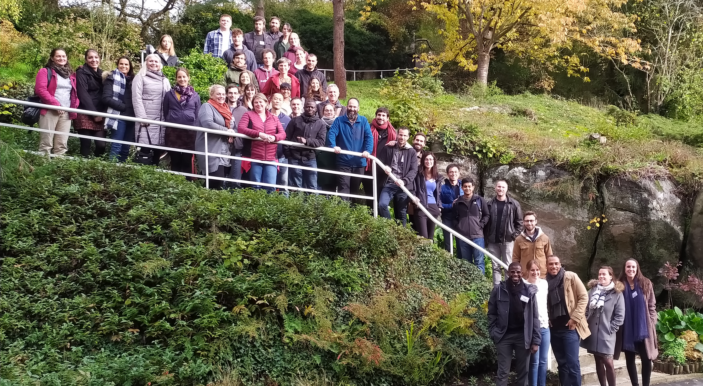
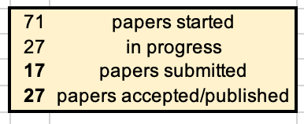
A long-term, massive collaborative effort
66 studies with 102 colleagues from 39 countries

Slide 54
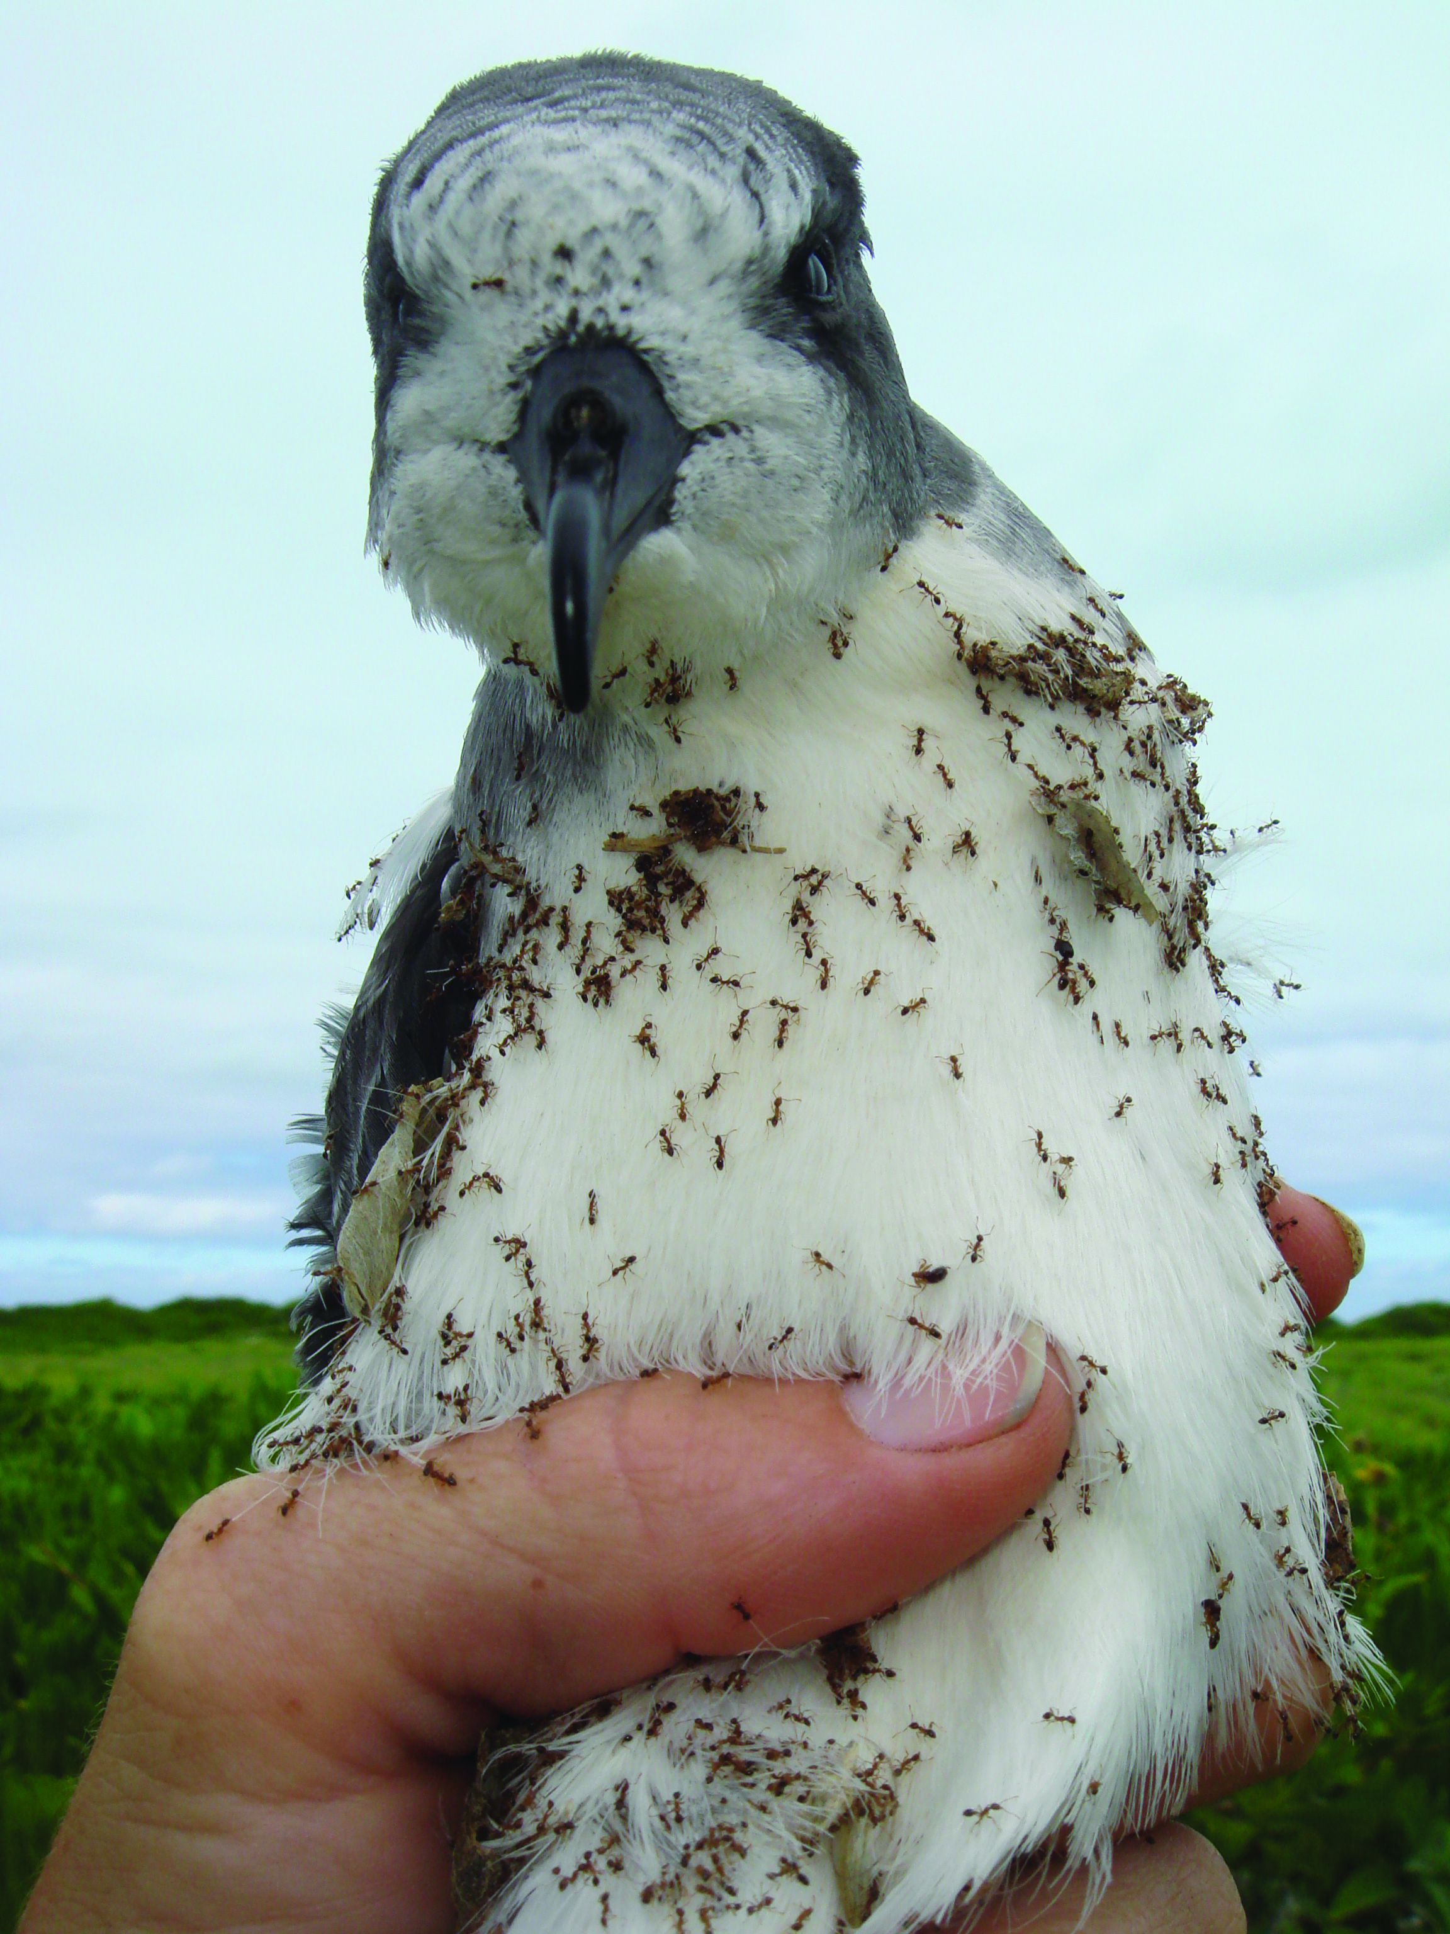

Results?

Slide 55
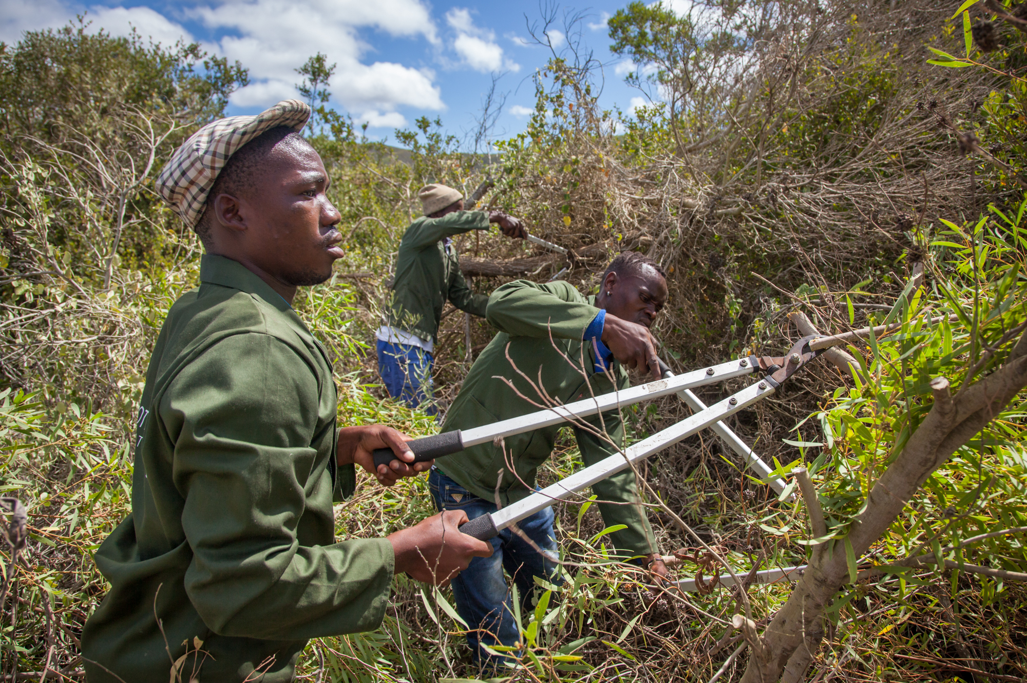
The costs are massive

Slide 56

The costs are massive
Invasive species cost globally a minimum of
1,288 trillion $
(a million millions $)
(1970-2017)
16
162.7 billion $ in 2017

Slide 57
The costs are massive
This average annual cost largely exceeds the GDP of 50 out of 54 countries on the African continent in 2017
162.7 billion $ in 2017

Slide 58


The costs are massive
This average annual cost largely exceeds the GDP of 50 out of 54 countries on the African continent in 2017
and is >20 times higher than the total funds available for the World Health Organization and the United Nations combined
162.7 billion $ in 2017

Slide 59
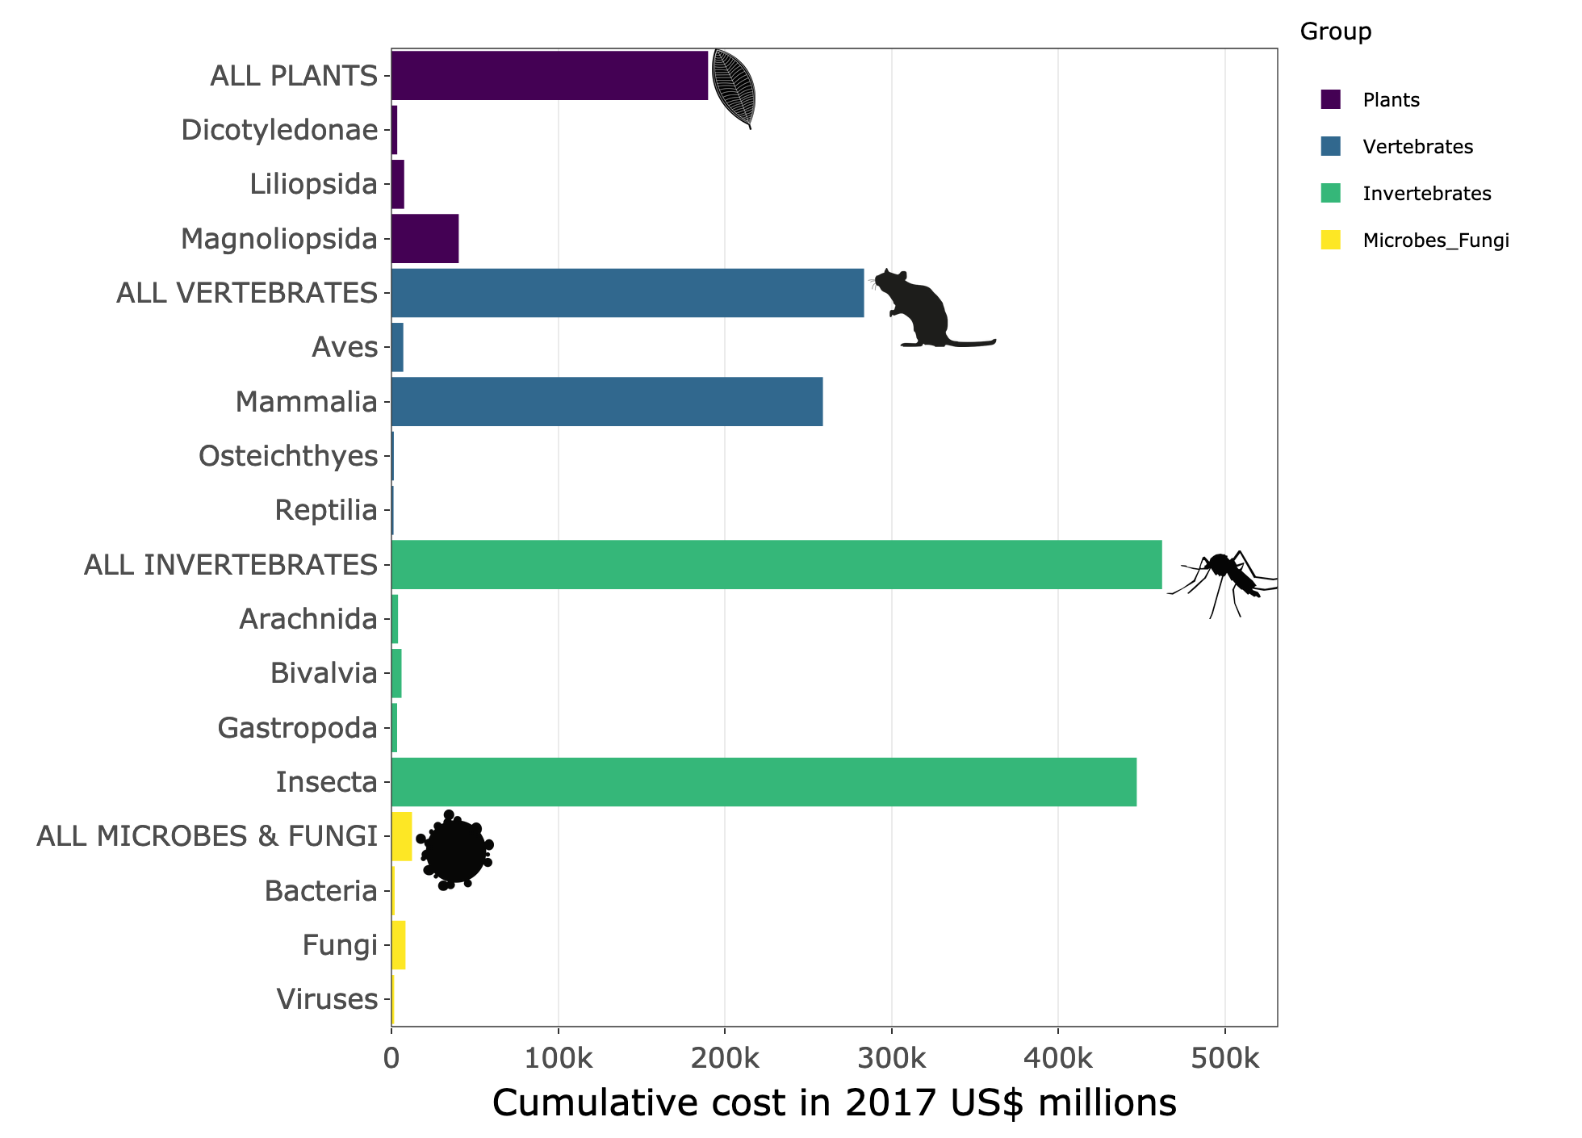
The costs are unevenly distributed
Costs by species

Slide 60
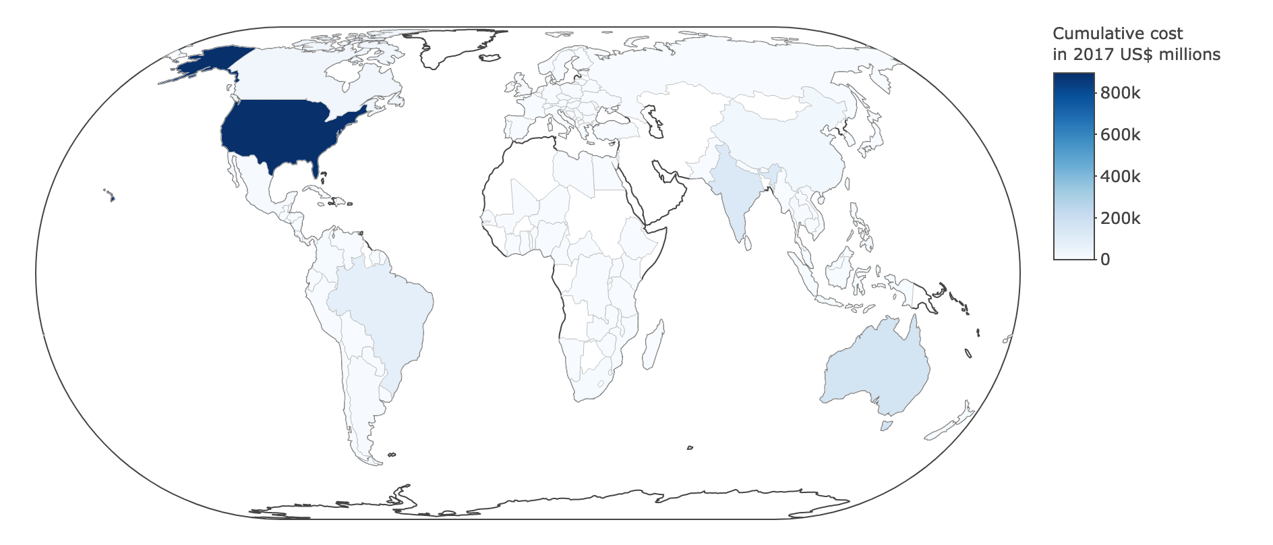
The costs are unevenly distributed
Costs by regions

Slide 61
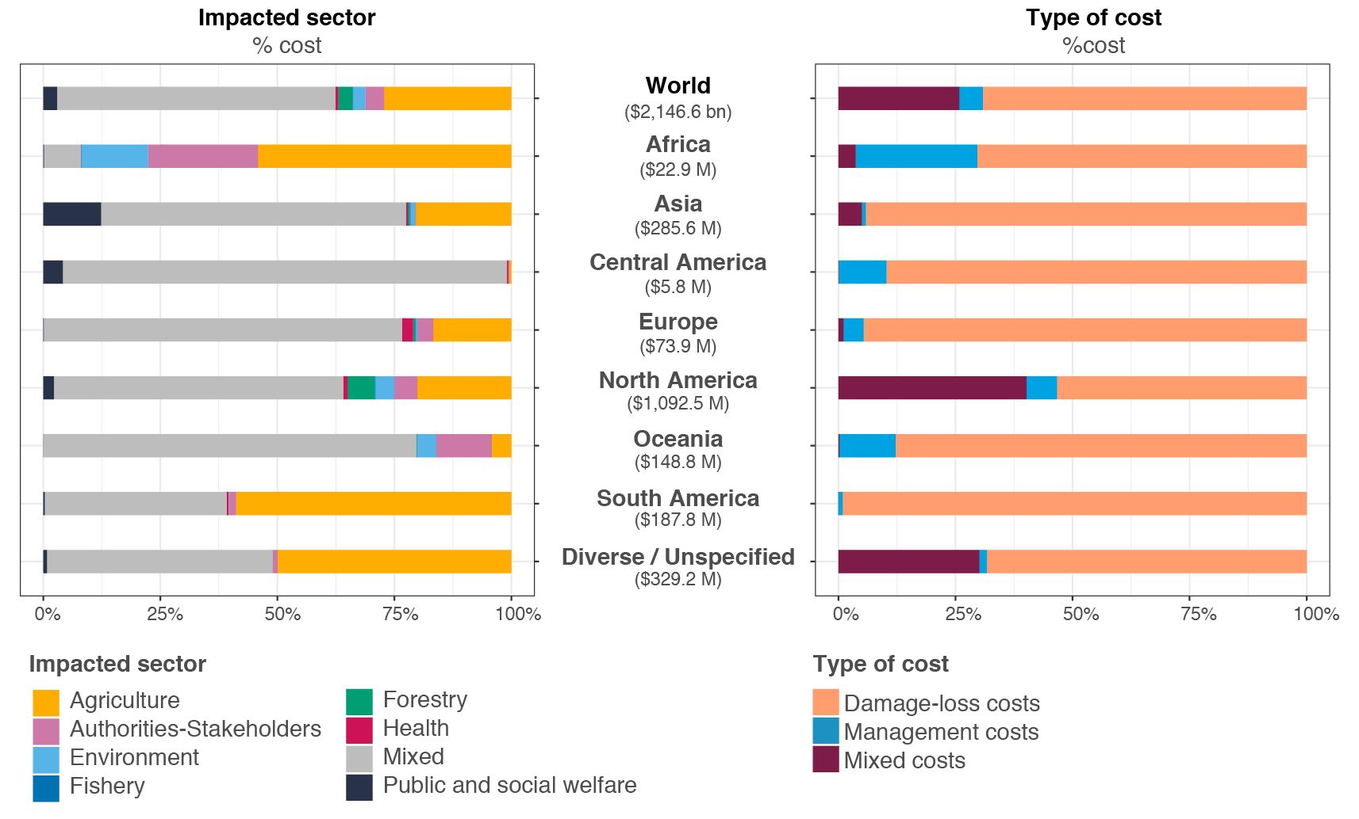
The costs are unevenly distributed
Costs by impacted activity sector

Slide 62
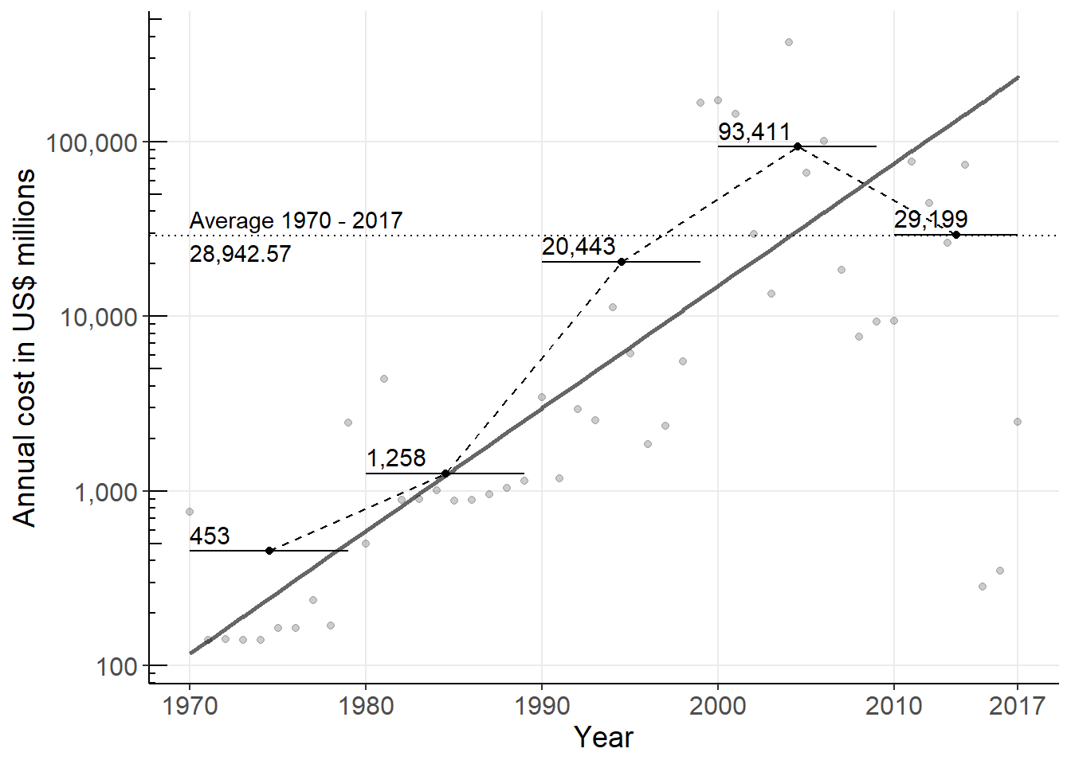
The costs have been increasing
(Log scale)
Costs by years

Slide 63
The costs have been increasing
(Log scale)
Costs by years

Slide 64
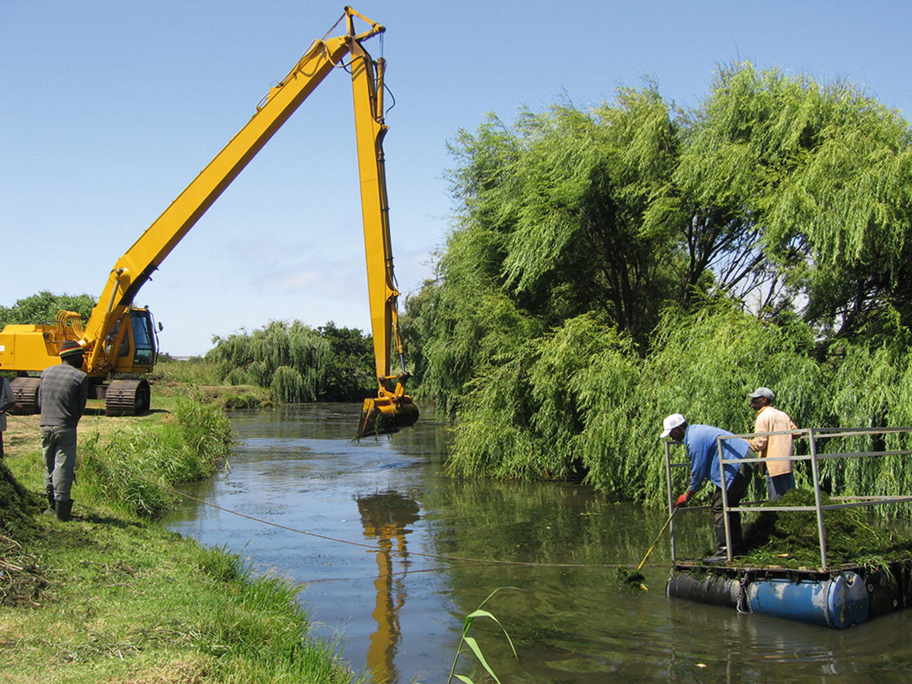
The costs are unevenly distributed
Management is very costly, but it is still worth managing, as losses are even more important
Costs by nature

Slide 65
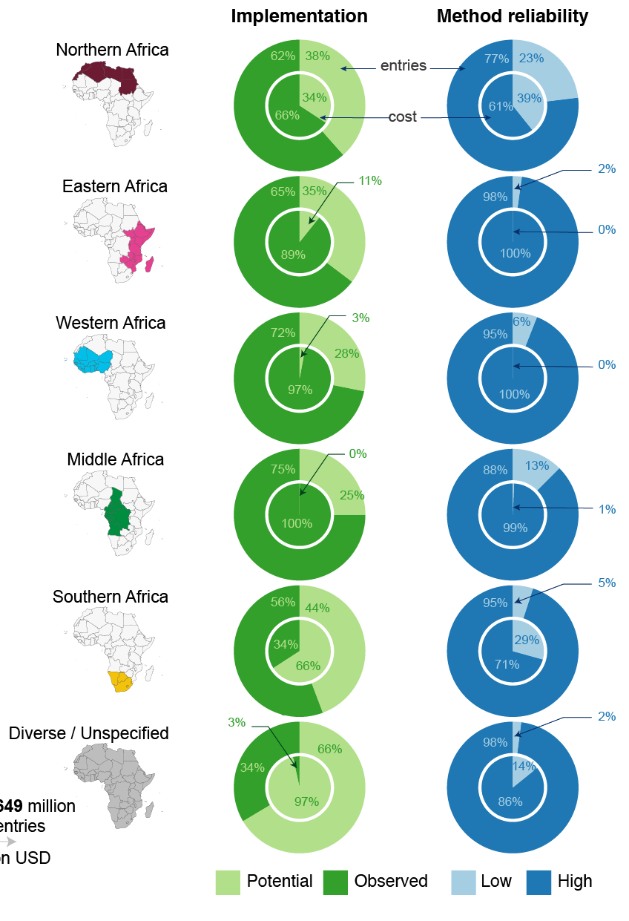
The costs are unevenly distributed
Costs by implementation and by reliability

Slide 66
The costs are unevenly distributed
Costs by impacted activity sector

Slide 67
The costs are unevenly distributed
Costs by taxa/regions/activity sectors

Slide 69
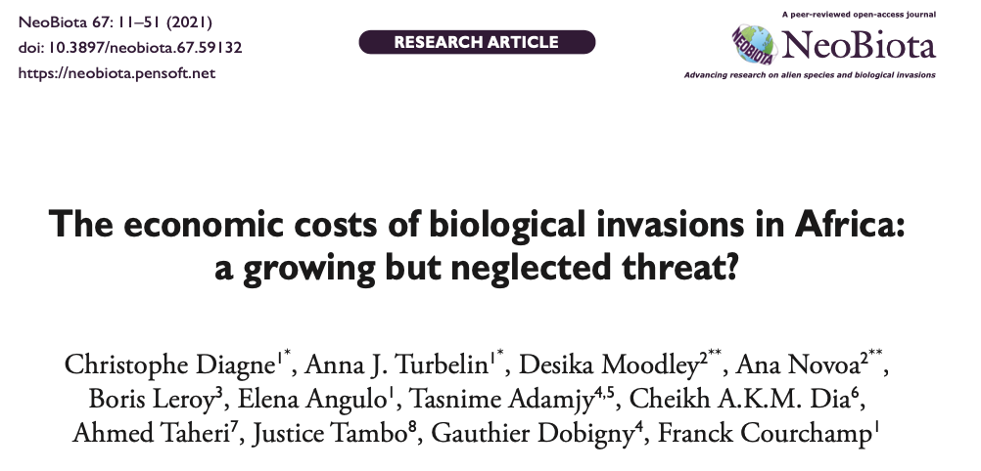
The costs in Africa

Slide 70
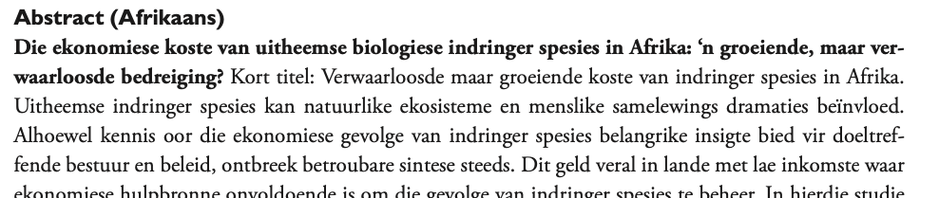
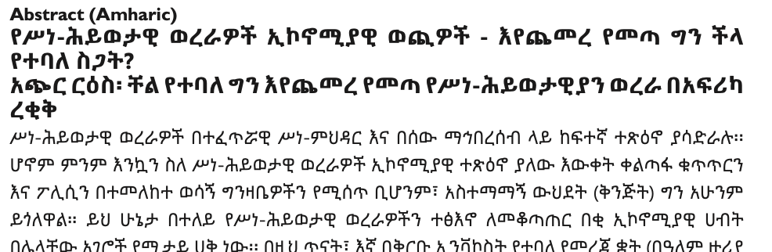
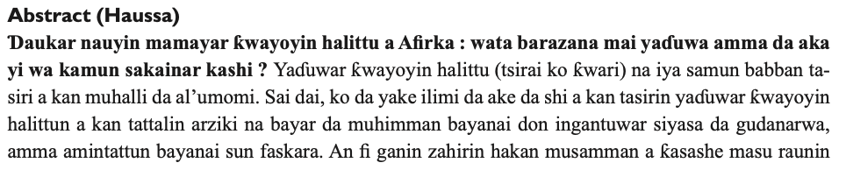
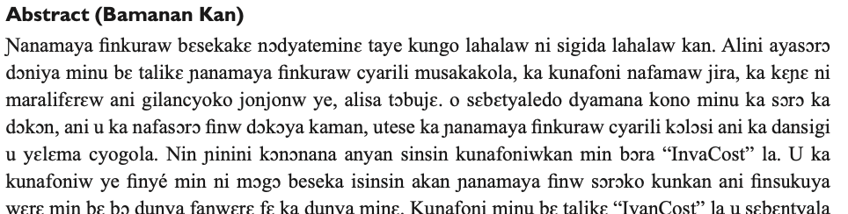
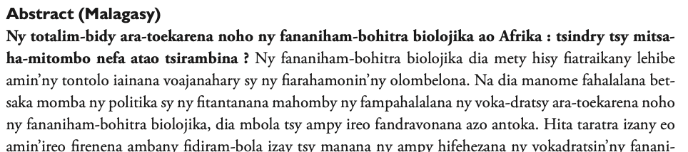
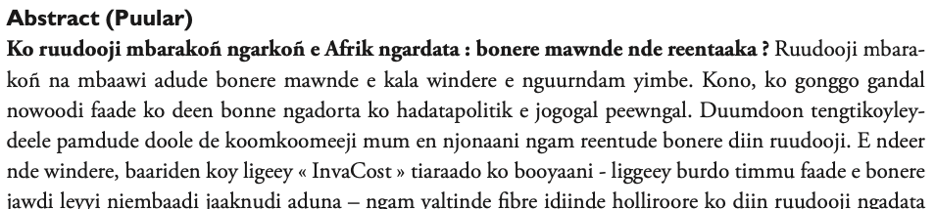
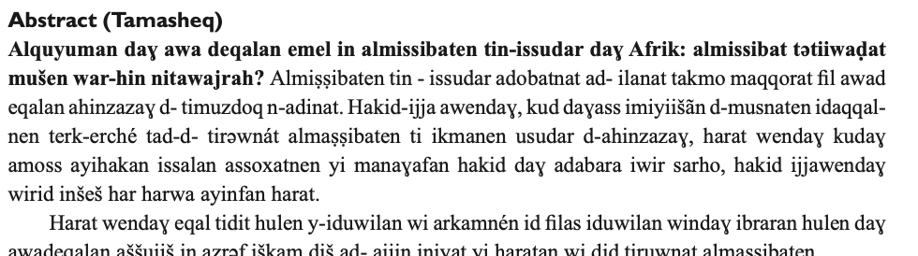
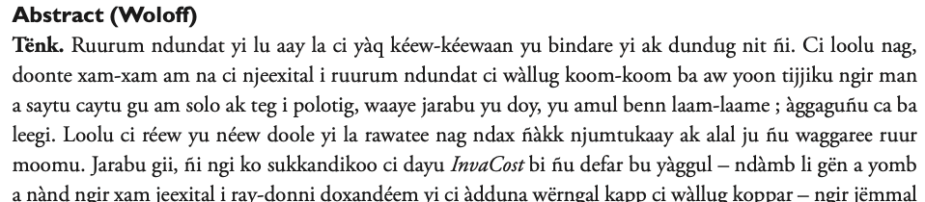

The costs in Africa
Abstracts in 14 languages!

Slide 71




The costs in Africa

Slide 72

Accurate estimate?
No!
Overestimations
Underestimations

Slide 73
Accurate estimate?
No!
Some dubious accounts
Many values missing
Some multiple counts
Conservative approach
Overestimations
Underestimations
We have been working on that!

Slide 74

The costs are massively underestimated
Invasive species cost globally a minimum of
1.288 trillion $
(1970-2017)
162.7 billion $ in 2017

Slide 75
The costs are massively underestimated
5 sources of under-estimation
1,288 billions $
Less robust costs
Missing costs
Taxonomic gaps
Geographic gaps
Temporal gaps
General biases in research efforts …
Less reliable costs
Extrapolated costs
Unaccessible costs
Unaccessible documentation
Confusion in invasive terminology (ie pest vs invasive)
Unindentified reports / articles
Non monetized costs
For example, for health:
Revenue losses
Salary of health and research staff
Education losses
Non-monetizable costs
Non-market costs, for example:
Value of a species impacted by an invasion
Value of an ecosystem disturbed by an invasion

Slide 76

The costs have been increasing
(about x3 every decade)

Slide 77


The costs have been increasing
(about x3 every decade)

Slide 78

The costs may further increase
With increased global trade and climate change, biological invasions are likely to be more frequent and widespread

Slide 79
The costs may further increase
With increased global trade and climate change, biological invasions are likely to be more frequent and widespread
→ Invasion debt (lag between introduction and impact (~50 years))
→ Report lag (lag between the cost and its report in the literature)
→ Invasion increases (no saturation)
→ Global trade increase (more introductions)
→ Climate change increase (more establishments)

Slide 80

Conclusion
Economic costs of biological invasions are massive
Economic costs of biological invasions are massively underestimated
Economic costs of biological invasions are diverse & heterogeneous
Economic costs of biological invasions are likely to keep increasing

Slide 81


Conclusion
We need more and better studies that estimate the economic costs of alien invasive species
- More invasive species
- More regions
- More types of costs
- More standardized

Slide 82

Conclusion
Biological invasions are really problematic, and should be prevented, managed and studied

Slide 83
Conclusion
It’s not all about money
Biodiversity losses are a major concern

Slide 84



Thank you!
(I also know Bok (hello) and Pivo (beer))

Slide 86
The costs are massively underestimated
5 sources of under-estimation
We did not find all studied costs
Costs in many non-English languages

Slide 87

The costs are massively underestimated
5 sources of under-estimation
We did not find all studied costs
Only most reliable entries used (~55%)

Slide 88


The costs are massively underestimated
5 sources of under-estimation
Ecosystem services, which have high economic value worldwide, are notoriously difficult to monetize
We did not find all studied costs
What is the value of an extinct species?
Only most reliable species used (~55%)
Some values not studied

Slide 89

The costs are massively underestimated
5 sources of under-estimation
We did not find all studied costs
Only most reliable species used (~55%)
Often less than 5-10% of known IAS had costs
Some values not studied
Some species not estimated

Slide 90
The costs are massively underestimated
5 sources of under-estimation
We did not find all studied costs
Only most reliable species used (~55%)
Some values not studied
Some species not estimated
Lower costs because fewer studies
Some regions are understudied

Slide 91


Different types of impacts

Slide 92




